Slide 1

Pattern Recognition
Chapter 1: Introduction
Chumphol Bunkhumpornpat
Department of Computer Science
Faculty of Science
Chiang Mai University

Slide 2
Learning Objectives
Be able to define pattern recognition
Understand its importance in various applications
Be able to explain the two main paradigms for pattern recognition problems

Slide 3
What is Pattern Recognition?
Pattern recognition can be defined as the classification of data based on knowledge already gained or on statistical information extracted from patterns and/or their representations.

Slide 4
Multimedia Document Recognition (MDR)
We have to deal with a combination of text, audio and video data.
The text data may be made up of
alpha-numerical characters corresponding to one or more natural language.
The audio data could be in the form of speech or music.
The video data could be a single image or a sequence of images.

Slide 5
MDR (cont.)
The face of a criminal, his fingerprint and signature could come in the form of a single image.
It is also possible to have a sequence of images of the same individual moving in an airport in the form of a video clip.

Slide 6
MDR (cont.)
Based on the multimedia data of an individual, in the form of fingerprints, face and speech, we can decide whether he is a criminal or not.

Slide 7
Pre-Processing of Data
In a typical pattern recognition application,
we need to process the raw data and convert it into a form that is amenable for a machine to use.

Slide 8
Pre-Processing of Data (cont.)
It may be possible to convert all forms of
a multimedia data into a vector of feature values.

Slide 9
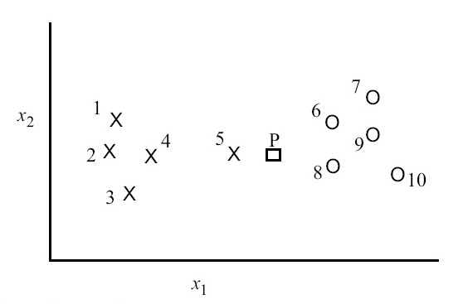
Example Set of Patterns

Slide 10
Example Set of Patterns (cont.)
There are patterns of Class X and Class O.
Pattern P is a new sample which has to be assigned either to Class X or Class O.

Slide 11
Example Set of Patterns (cont.)
In a system that is built to classify humans into tall, medium and short, the abstractions, learnt from examples, facilitate assigning one of these class labels (“tall”, “medium” or “short”) to a newly encountered human.

Slide 12
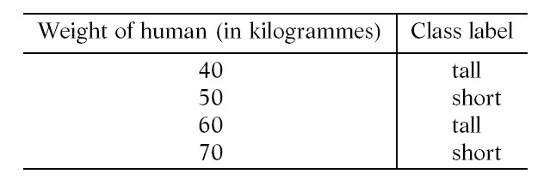
Classification of Humans into Group
“tall” or “short” Using Feature “weight”

Slide 13
Classification of Humans into Group
“tall” or “short” Using Feature “weight” (cont.)
A pattern is represented as a vector of feature values.
Consider the data shown in the table where humans are to be categorised into two groups “tall” and “short”.

Slide 14
Classification of Humans into Group
“tall” or “short” Using Feature “weight” (cont.)
The classes are represented using feature “weight”.
If a newly encountered person weighs 46 kg, then he/she may be assigned the class label “short” because 46 is closer to 50.

Slide 15
Classification of Humans into Group
“tall” or “short” Using Feature “weight” (cont.)
However, such an assignment does not appeal to us because we know that the weight of an individual and the class labels “tall” and “short” do not correlate well; a feature such as “height” is more appropriate.

Slide 16
Machine Learning Repository at UC Irvine
www.ics.uci.edu/MLRepository.html
It contains a number of data sets of varying sizes which can be used by any classification algorithms.

Slide 17
Machine Learning Repository at UC Irvine (cont.)
Many of them even give the classification accuracy for some classification methods which can be used as a benchmark by researchers.

Slide 18
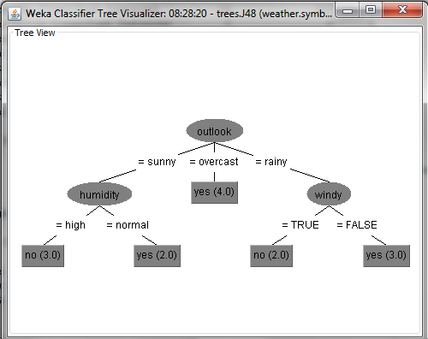
Weka

Slide 19
Different Paradigms for Pattern Recognition
Statistical Pattern Recognition
Syntactic Pattern Recognition

Slide 20
Statistical Pattern Recognition
Most practical problems in this area deal with noisy data and uncertainty––statistics and probability are good tools to deal with such problems.

Slide 21
Syntactic Pattern Recognition
Formal language theory provides the background for this area and systems based on such linguistic tools are not ideally suited to deal with noisy environments.

Slide 22
Vector Space
We use vector spaces to represent patterns and classes.
The abstractions typically deal with probability density/distributions of points in multi-dimensional spaces.

Slide 23
Vector Space (cont.)
Because of the vector space representation, it is meaningful to talk of sub-spaces/projections and similarity between points in terms of distance measures.

Slide 24
Reference
Murty, M. N., Devi, V. S.: Pattern Recognition: An Algorithmic Approach (Undergraduate Topics in Computer Science). Springer (2012)
Witten, I. H., Frank, E., Hall, M. A.: Data Mining: Practical Machine Learning Tools and Techniques, 3rd Edition. Morgan Kaufman (2011)

